Slide 1
Producing Electricity from Wind
Wind Turbines and WindMills

Slide 2
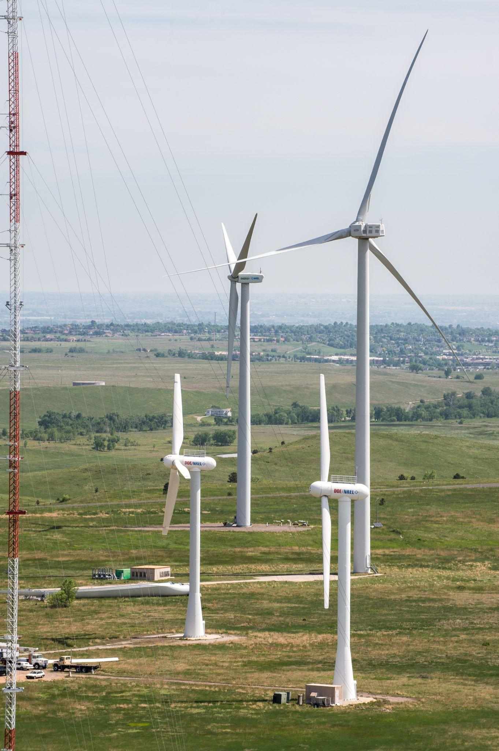
What are wind turbines used for?
Photo by Dennis Schroeder/NREL
Notes:
These are used to generate electricity.

Slide 3
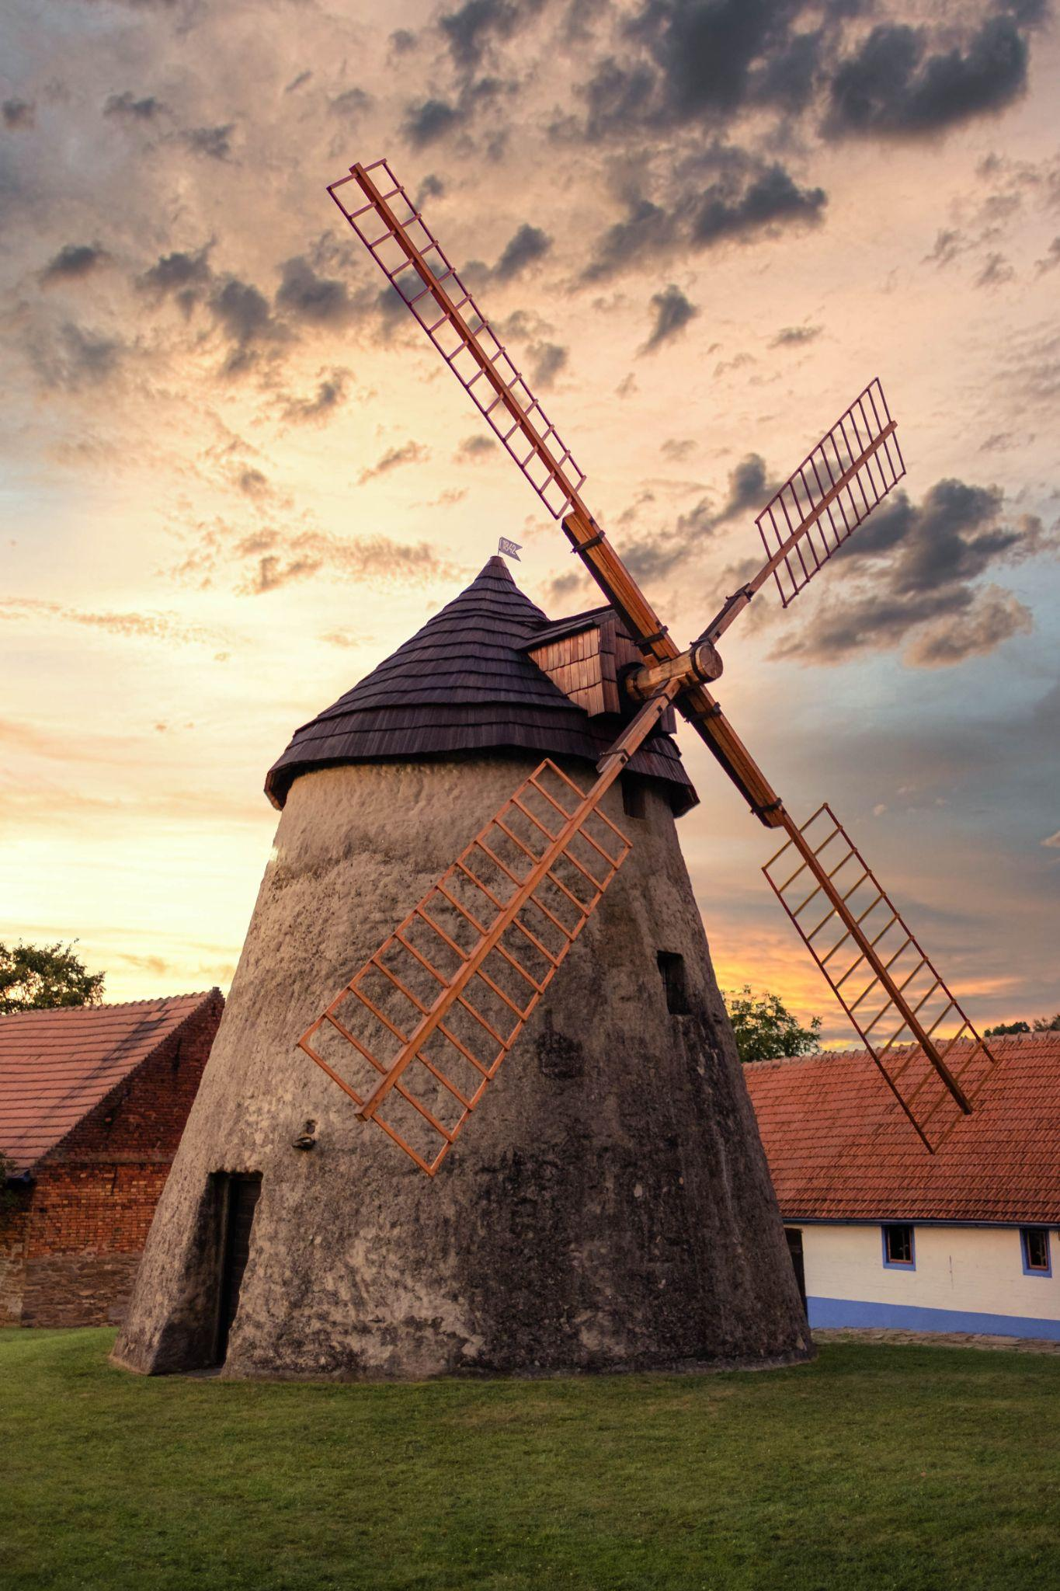
Where have you seen this type of windmill?
Photo Source Pexels by Andrej Zeman
Notes:
This type is from Holland and is used to pump water off of the land.

Slide 4
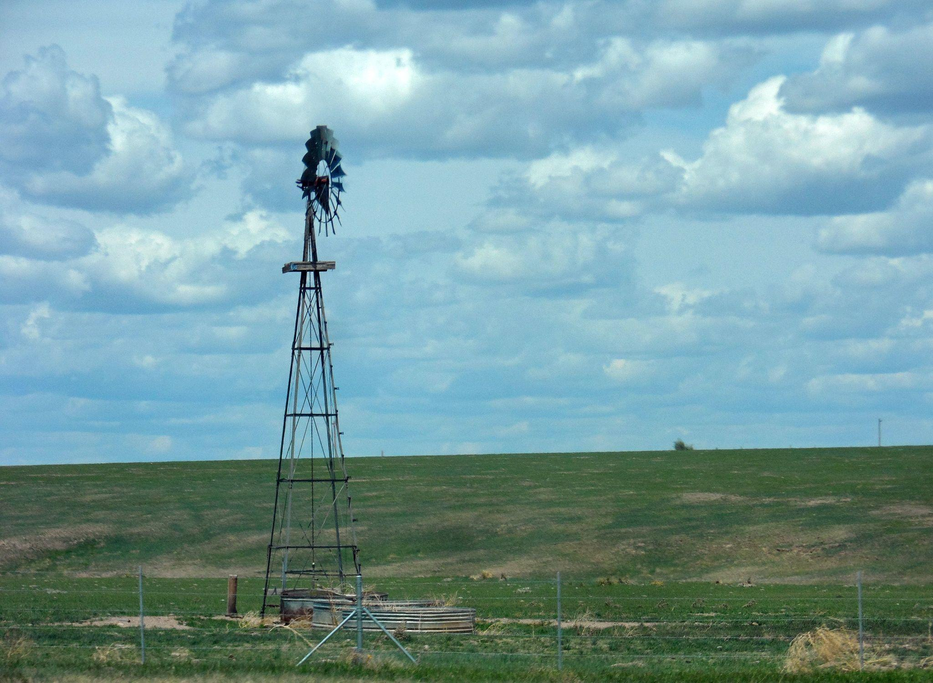
We see this type of windmill on the plains. What is it used for?
Photo Source Pexels by Aaron Fox
Notes:
This windmill is for pumping water out of the ground.

Slide 5
How about this one from 1888?
Image Source Public Domain
Notes:
This was the 1st U.S. turbine used to generate electricity. Invented by Charles Brush from Cleveland, Ohio The turbine’s diameter was 17 meters (50 feet), it had 144 rotor blades made of cedar wood, and it generated about 12 kilowatts of power.

Slide 6
When the blades move what happens?
Water is pumped
Grain is ground up
Turn a wheel that will do some kind of work
Electricity is generated

Slide 7
Do you think the design of the structure or the blades affect how fast they turn?
Modern wind turbines have two or three long, light-weight blades that turn quickly.
The longer the blade and the greater the wind speed, the more electricity generated.
Steady wind speeds of no less than 12 miles per hour year round are required to effectively generate electricity.

Slide 8
What does the inside of a modern wind turbine look like?
Diagram courtesy of electricalacademia.com

Slide 9
A Simpler Picture
Source from NEED.org

Slide 10
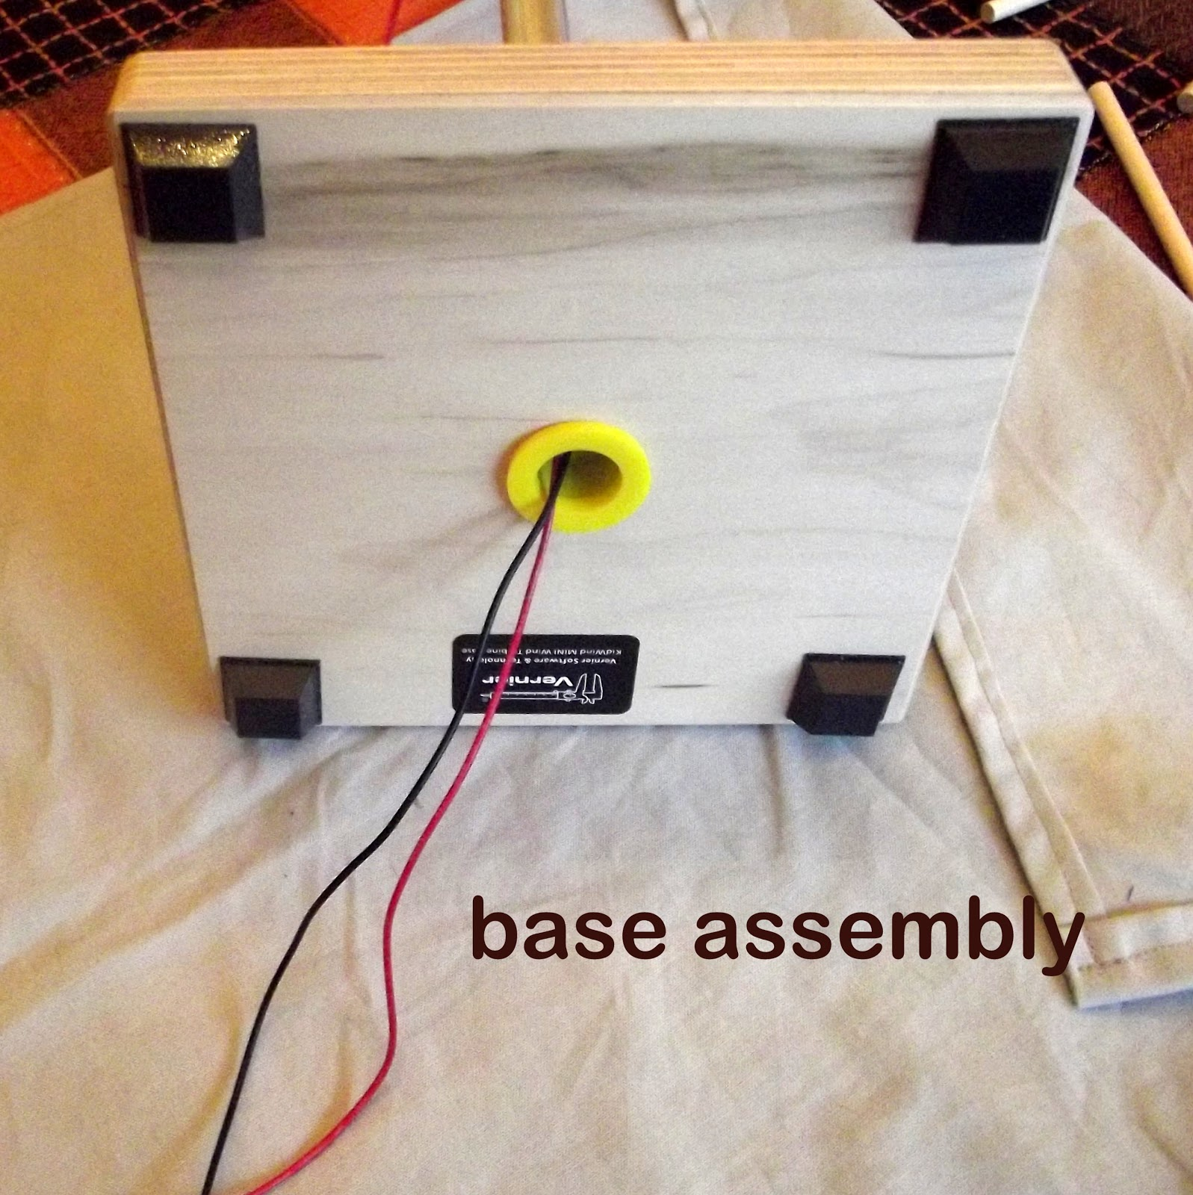
EXPLORATION:
Set up the wind turbine using the red blades. Look at the picture.
Photo by Van Barker

Slide 11
Photo by Van Barker

Slide 12
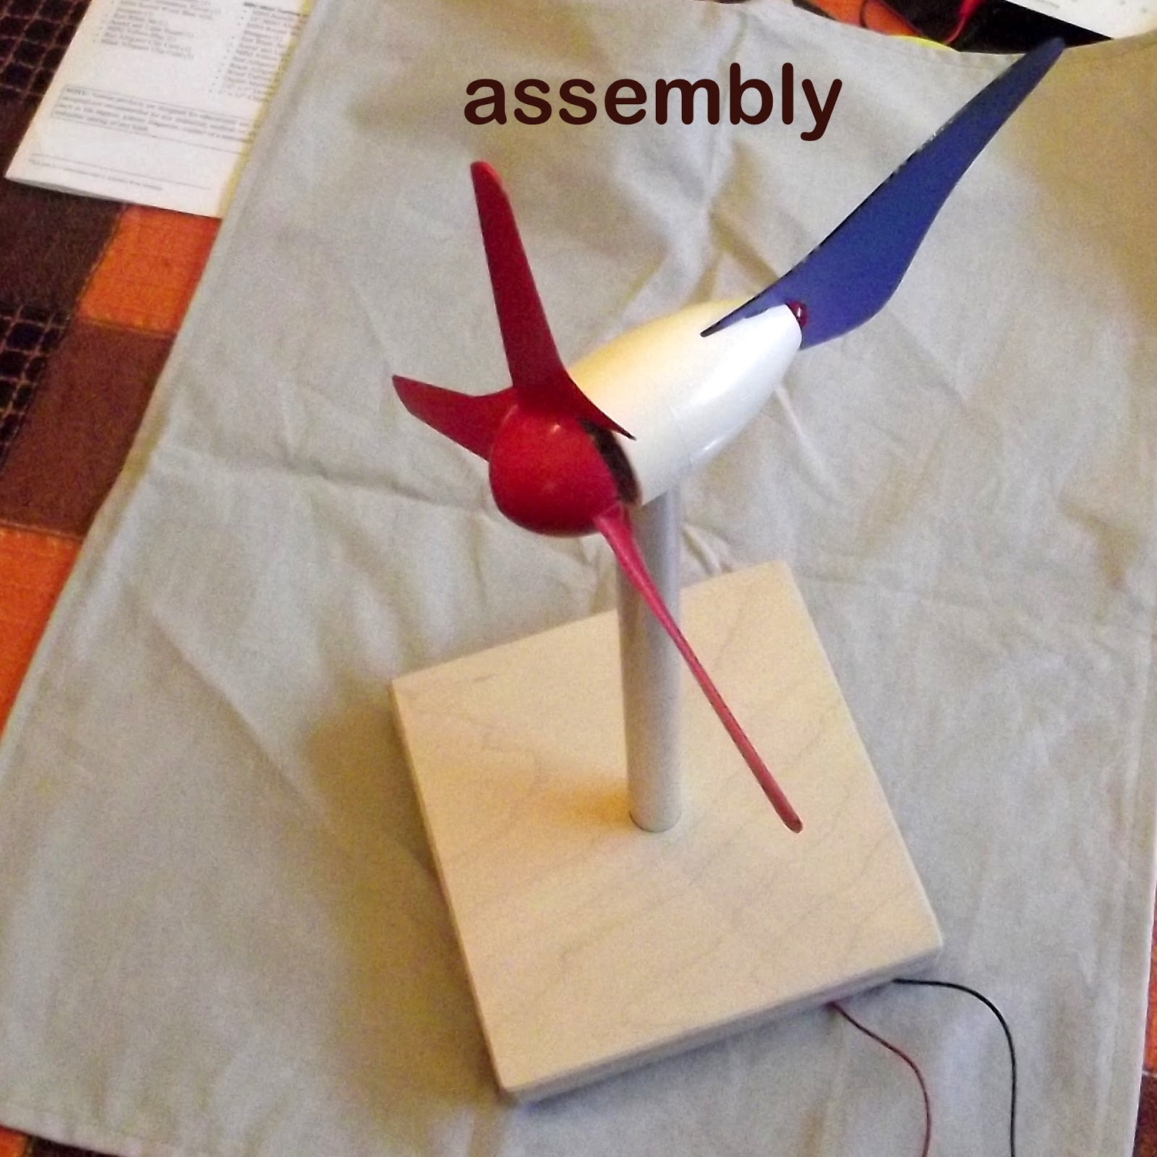
Photo by Van Barker

Slide 13
Connect the wires to the interface board and turn the fan on to medium, see if you can get the music to play.
Answer the questions on the student sheet
Now let’s look at blade design.

Slide 14
Take off the red blades and use the hub.
Photo by Van Barker

Slide 15
Design blades for your turbine
Materials you could use:
Cardboard
Paper plates
Construction paper
Plastic cups
Balsa wood

Slide 16
Set up the wind turbine using the hub with the fan 2 meters away and attach the wires of the turbine to the multimeter.
This is your testing area.
Once your blades are designed, test your blades.
Answer the questions on the student sheet.

